Slide 1

TITLE
"Attendance for Course Management"

Slide 2

TEAM
Pradyot Paul
Krishnik Barman
Rollno.-> 202202022120
Semester-> 5th
Rollno.:-> 202202022104
Semester-> 5th

Slide 3

OUR VISION
To build a website that helps to take attendance of students for a course managment in an institution and saves the attendance data for future.

Slide 4




HTML : Structure of the webpage (form, table, etc.)
Technologies
Used
CSS : Styles and layout of the page (responsive design, table styles)
JavaScript : Interactivity and data handling (form submissions, dynamic table updates).
Virtual Code: Interactivity and data handling (form submissions, dynamic table updates).

Slide 5


FUNCTIONAL FLOW
Step 1: Instructor enters student information (name, ID, course).
Step 2: Select attendance status (Present or Absent).
Step 3: Click "Submit" to save the attendance data.
Step 4: Attendance records are displayed in a table.
Save the records to a .txt file for later use.

Slide 6
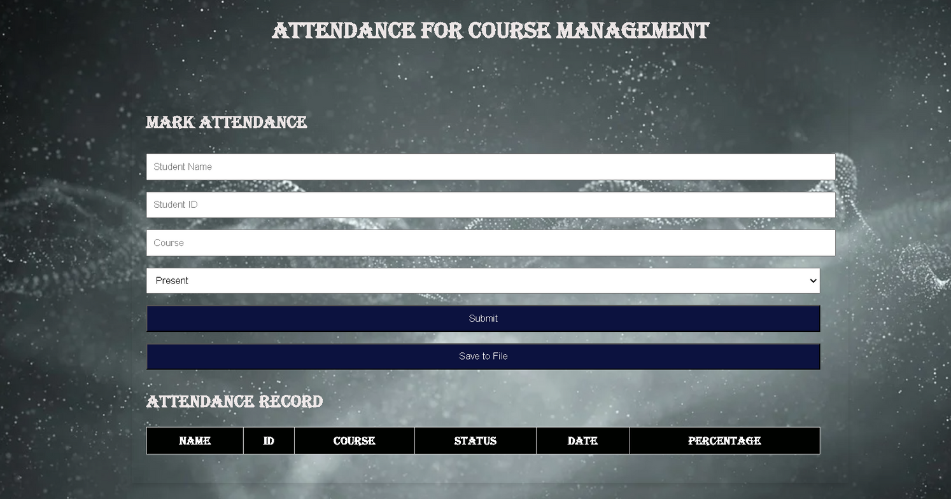
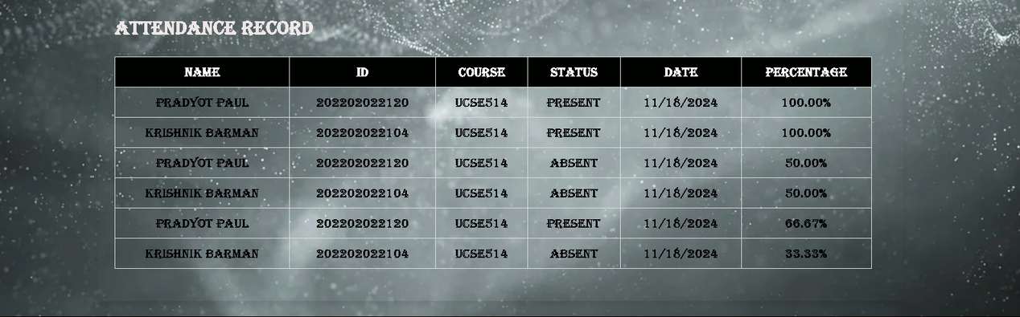
WEBSITE DISPLAY
After Data:
Before Data:

Slide 7

CONCLUSION & FUTURE WORK
Conclusion:
The app provides an easy and efficient way to track and save student attendance.
It is user-friendly, as it doesn't require a database (data is stored in memory).
Future Work:
Database Integration: To persist data beyond the browser session.
Improved User Interface: Add more styling, user feedback on submission, etc.

Slide 8
THANK YOU!
FOR YOUR ATTENTION

